Slide 1

Introduction
Python Fundamental
Tan See Youu

Slide 2
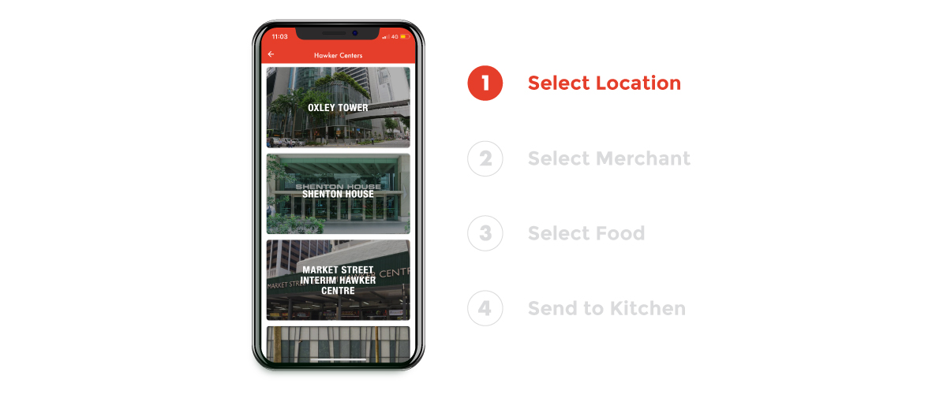
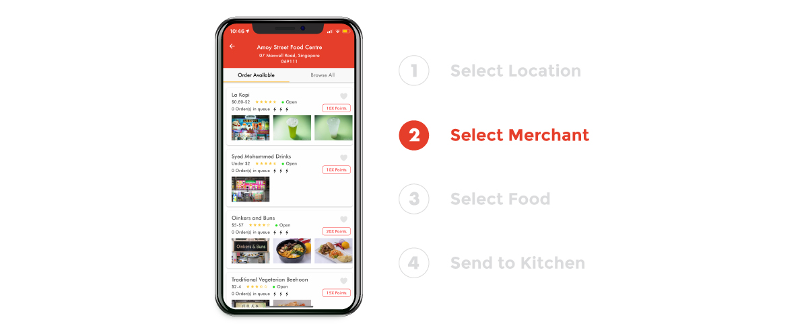
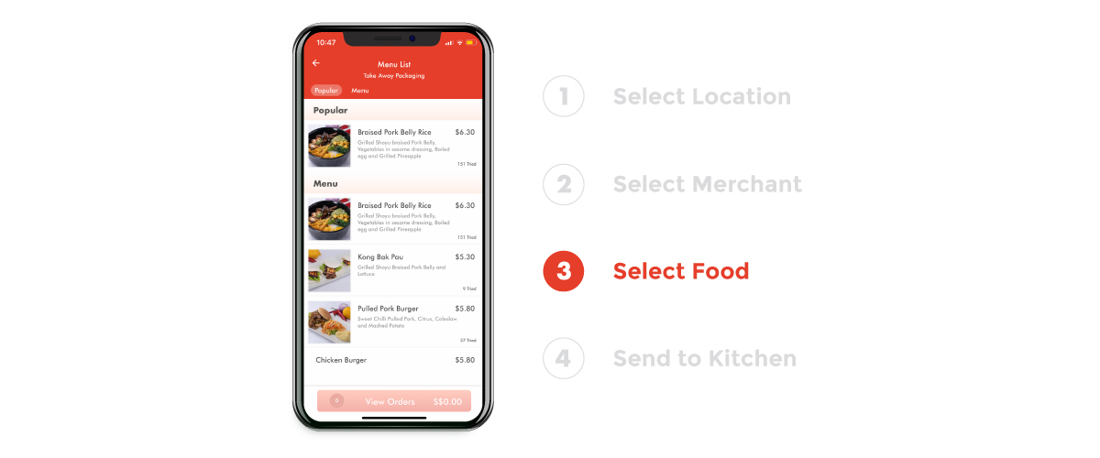
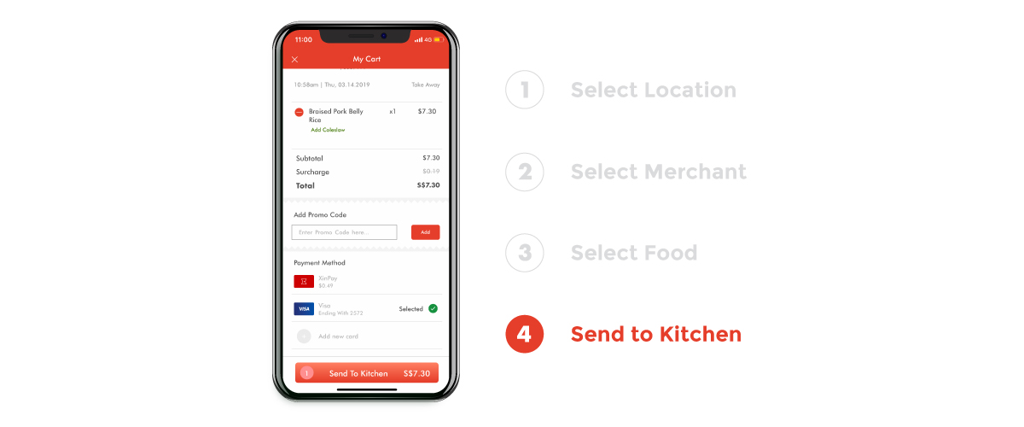
Self introduction
Tan See Youu
Developer Team Lead at Qixiang Techonology
10 years experiences in Web application
5 years in Python programming
Current work:
Design and implement Xindots App Framework

Slide 3
Overview
Python setup – Python installation, Jupyter notebooks, Git and etc.
Data structure – Numbers, Strings, Lists, Dictionaries and etc.
Operators and statements
Methods and functions – Methods, functions, lambda expression
Object oriented programming(OOP) and modules
Logging, Errors and exception handling

Slide 4
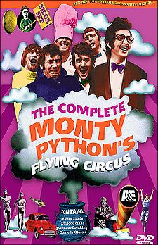

What is Python?
Beautiful is better than ugly.
Explicit is better than implicit.
Simple is better than complex.
Complex is better than complicated.
Flat is better than nested.
Notes:
Python is an interpreted, high-level, general-purpose programming language. Created by Guido van Rossum and first released in 1991, Python's design philosophy emphasizes code readability with its notable use of significant whitespace. Its language constructs and object-oriented approach aims to help programmers write clear, logical code for small and large-scale projects.
Python is dynamically typed and garbage-collected. It supports multiple programming paradigms, including procedural, object-oriented, and functional programming. Python is often described as a "batteries included" language due to its comprehensive standard library.
Python is meant to be an easily readable language. Its formatting is visually uncluttered, and it often uses English keywords where other languages use punctuation. Unlike many other languages, it does not use curly brackets to delimit blocks, and semicolons after statements are optional. It has fewer syntactic exceptions and special cases than C or Pascal.

Slide 5
Advantages of Python
Less coding required (Simple)
Learning Ease and Support Available (Simple)
Clean code and easy to understand (Beautiful)
User-friendly Data Structures (Explicit)
Presence of Third Party Modules (Flat)
Extensive Support Libraries(Flat)
Productivity and Speed(Simple)
Notes:
Follow previous (zen of python)

Slide 6
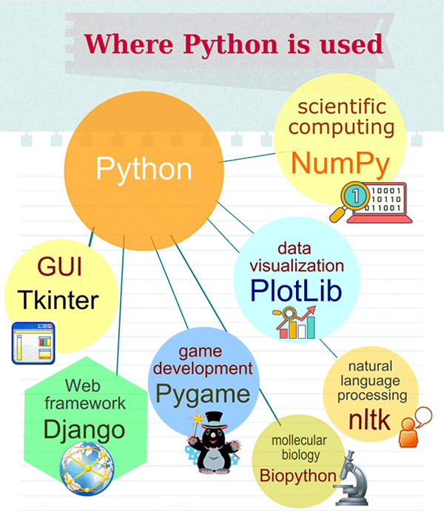
Applications of Python Programming

Slide 7
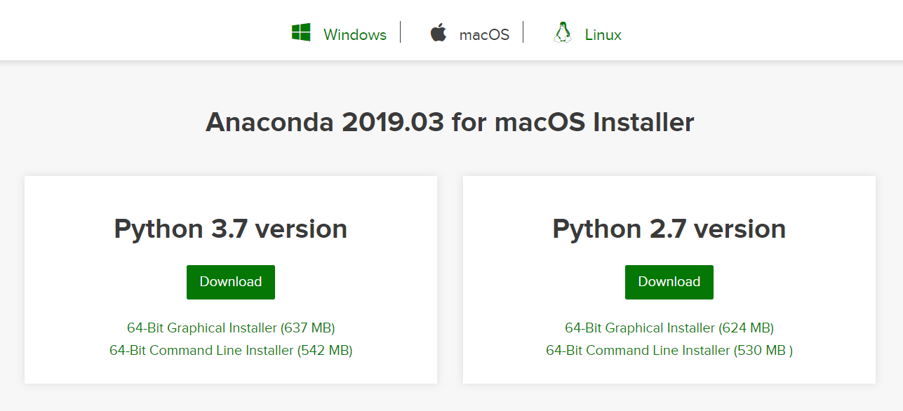
Python setup
To Install, visit : https://www.anaconda.com/distribution/#download-section

Slide 8
Development Environment
There are several ways to run Python
There are 3 main types of environments
Text Editors
Full IDEs
Notebook environments

Slide 9
Text Editors
General Editor for any text file
Work with a variety of file types
Can be customized with plugins an add-ons
Most are not designed for only Python
Most popular: sublime text, VS Code

Slide 10
Full IDEs
Development Environment Designed specifically for Python
Larger Program
Most of them need to pay
A lots of extra functionally tailored for Python
Most popular: PyCharm

Slide 11
Notebook Environments
Great for learning
See input and output immediately next to each other
Support in-line markdown notes, visualizations, videos and more
Special file format which isn’t “.py”
Most popular: Jupyter Notebook

Slide 12
Running Python Code
Try text editor create a .py file and run it under command prompt
Try using Jupyter Notebook for the same code in .py file

Slide 13
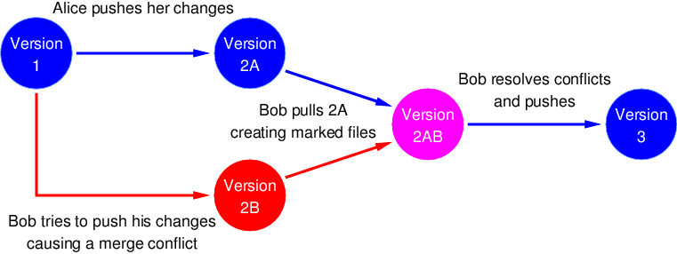
Git – Resolve conflict in collaboration
Imagine 2 developers in a team changed a same code file, whose version will be the final version?
In order to resolve conflict scenario, here we introduce GIT
Notes:
Git is a distributed version-control system for tracking changes in source code during software development. It is designed for coordinating work among programmers, but it can be used to track changes in any set of files. Its goals include speed data integrity and support for distributed, non-linear workflows.
GitHub, a subsidiary of Microsoft, is an American web-based hosting service for version control using Git. It is mostly used for computer code. It offers all of the distributed version control and source code management (SCM) functionality of Git as well as adding its own features.

Slide 14
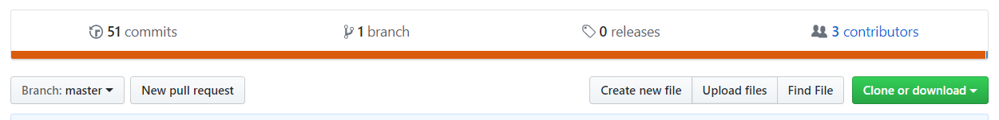
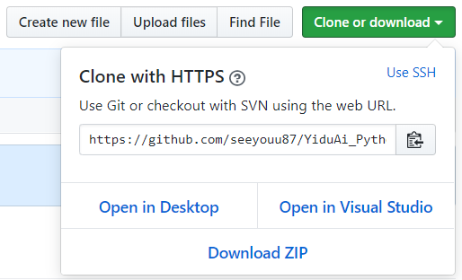
Download Course Material from GitHub
Visit https://github.com/seeyouu87/YiduAi_Python_fundamental and Download the repository as Zip file
Click HERE FIRST
THEN CLICK HERE

Slide 15
Solve 2 problems by end of this course
Robo-advisor
Survey form application for insurance agency

Slide 16
Python Syntax
Line by line execution
Using indentation to mark blocks of code
Check Jupyter notebook for demo

Slide 17
Data Types
Primitive type: Integers, Float, string, boolean
Non-primitive type: list, tuple, dictionary, set
Name | Type | Description
Integers | int | Whole numbers, such as age = 32
Floating point | float | Numbers with a decimal point: 2.33, 4.66 (money value)
Strings | str | Ordered sequence of characters: “hello”, “same”, “1222”(any plain text)
Boolean | bool | Logical value indicating True or False (to represent status)
Name | Type | Description
List | list | Ordered sequence of objects: [10, “123”, True, 2.222] (to store ordered data)
Dictionaries | dict | Unordered key-value pairs: {“mykey”:”myvalue”, “age”:32} (to store value pairs require search)
Tuples | tup | Ordered immutable sequence of objects: (1,”hello”,3.333) (to store read-only list)
Sets | set | Unordered collection of unique objects: {“a”,123} (to store unique objects)
Notes:
Insert table: primitive & non-primitive

Slide 18
Number
Include floating number (interest rate) and integer (age)
Mainly used for mathematical operations
Example: annual_income = sum(monthly_income)
Future_value = current * (1+ interest_rate)

Slide 19
Boolean
Indicate True or False value ( is PR? Has housing loan?)
True: mean “yes” or “positive” in computer programming
Check Jupyter notebook for hands on

Slide 20
String
String literals in python are surrounded by either single quotation marks, or double quotation marks.
For example: name, address are string fields
Name =‘Tan See Youu’
Address=‘NUS COM2’

Slide 21
Example (profile summary)
Name: Tan See Youu (string)
Age: 32 (integer)
Is PR: True (Boolean)
Has Housing loan?: True (Boolean)
Is Single? : True (Boolean)
Address: “NUS COM2” (string)

Slide 22
List
List are ordered sequences that can hold a variety of object types
They use [] brackets and commas to separate objects in the list, eg: HDB type= [“1-Room”, “2-Room”, “3-Room”]
Sequences type in python are supporting index and reverse sequence, so besides [‘h’, ‘e’, ‘l’, ‘l’ , ‘o’][2], [‘h’, ‘e’, ‘l’, ‘l’ , ‘o’][-2] is also supported, you may refer to the table below for clearer understanding:
List support slicing
 | H E L L O
Index | 0 1 2 3 4
Reverse index | 0 -4 -3 -2 -1

Slide 23
Tuples
Tuples are very similar to lists, however they have one key differences – immutability.
Once an element is inside a tuple, it cannot be reassigned.
Tuples use parenthesis: (lat, lng)
Check Jupyter notebook for hands on

Slide 24
Differences between tuples and list
List | Tuple
Use square bracket to represent [] | Use parenthesis () to represent
List element can be modified: mylist = [1,2] mylist[0] = 3 Mylist = [3, 2] | Tuple is immutable t = (1, 2, 3), which t can only be read, cannot be modified

Slide 25
Dictionary
Dictionary are unordered mappings for storing objects. Similar to list store object in ordered sequence, Dictionary store object as key-value pair
This key-value pair allow users to quickly grab objects without needing to know an index location
Use curly braces {} and colons to signify the keys and their associated values. Eg: {‘key1’:’value1’, ‘key2’:’value2’}
{“name”:”tan see youu”, “age”:32}

Slide 26
Sets
Sets are unordered collections of unique elements
There can only be one representative of the same object. Eg: my_set=set() or {“AXA”,”AIA”,”Prudential”}
Python provide built-in method for sets operation such as union and intersection

Slide 27
Differences between list and sets
List | Sets
Use square bracket to represent [] | Use curly bracket {} to represent
List allow duplicate element such as: [1,2,2,2,3,3,3] | Sets doesn’t allow duplicate element

Slide 28

Thank You
Q&A

